Slide 1






PowerShell Conference Asia
PowerShell for SharePoint Online – (making SharePoint Admins feel loved again)

Slide 2

PowerShell for SharePoint Online – (making SharePoint Admins feel loved again)
Rick Taylor
Senior DevOps Engineer
ZAACT
PowerShell Conference
Singapore 2017

Slide 3
Who Am I?
The Guardian of Lost Souls
The Powerful
Rick Taylor
The Indestructible
The Pleasurable
PowerShell Conference
Singapore 2017

Slide 4

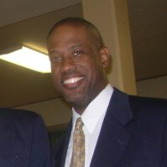
About the presenter
Richard Taylor
Sr. DevOps Engineer
Phoenix, AZ
Former member of Microsoft BPOS Architecture and OPSCon teams
Author, Co-author of Administrator's Guide version 2007, 2010 and 2013
Rick.Taylor@ZAACT.com
W
blogs.technet.microsoft.com/ritaylor/
@SLKRCK
PowerShell Conference
https://www.linkedin.com/in/slickrickistheman
Singapore 2017

Slide 5

PowerShell Conference Asia
PowerShell for SharePoint Online – (making SharePoint Admins feel loved again)

Slide 6
AGENDA
PowerShell – General
PowerShell – For SharePoint
PowerShell – For SharePoint Online
PowerShell Conference
Singapore 2017

Slide 7
Demo scripts
http://tinyurl.com/y9q63eot

Slide 8
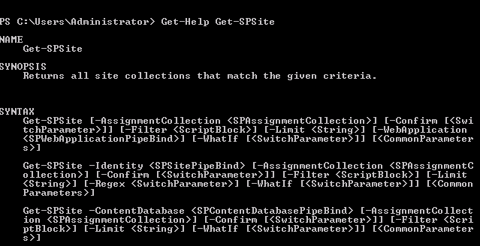
PowerShell
Get a list of all commands:
Get-Command –noun sp*
Get help for a specific command:
Get-Help <cmdlet>
PowerShell Conference
Singapore 2017

Slide 9
PowerShell
Scripting Syntax
Sample Script:
$password = Read-Host "What is the password for the accounts?" -assecurestring ; Get-Content usernames.txt | ForEach-Object {New-SPManagedAccount -password $password -username litwareinc\$_; Set-SPManagedAccount -identity $_ -autogenerate -confirm:$False}
Syntax | Description
$ | Denotes a variable.
; | Denotes completion of cmdlet, continue to next one.
| | Sends the output of the preceding cmdlet to the next cmdlet.
ForEach-Object { } | For each object, execute all the commands within the { }.
PowerShell Conference
Singapore 2017

Slide 10
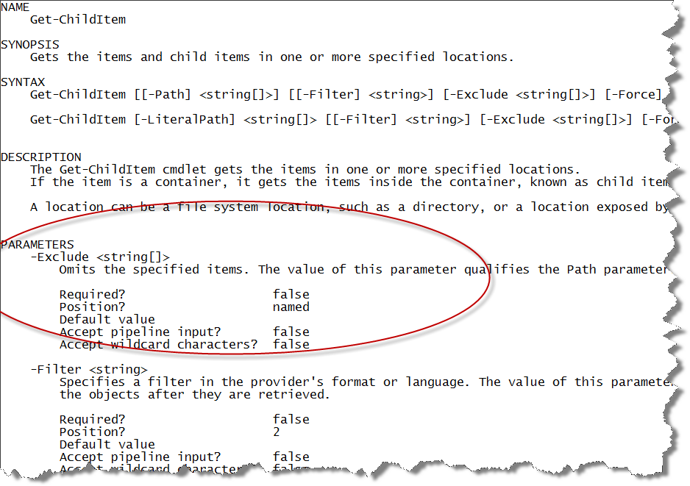
PowerShell Conference
Singapore 2017

Slide 11
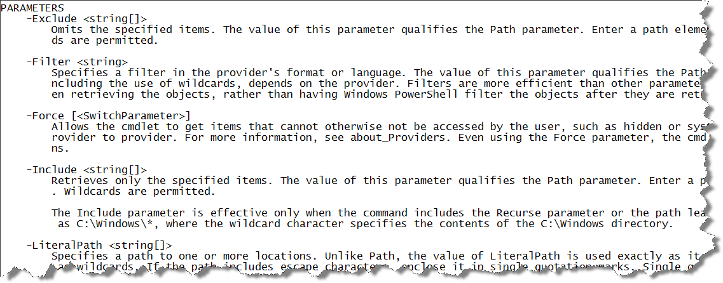
PowerShell Conference
Singapore 2017

Slide 12
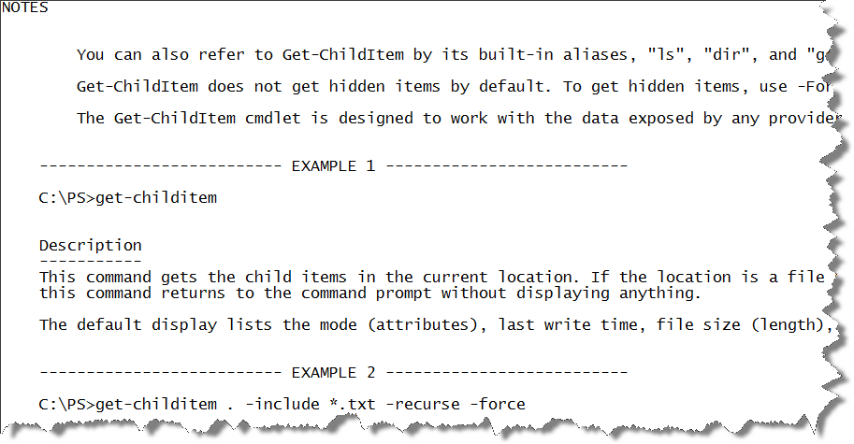
PowerShell Conference
Singapore 2017

Slide 13
PowerShell for SharePoint
Rick Taylor
Senior DevOps Engineer
ZAACT
PowerShell Conference
Singapore 2017

Slide 14
What about STSADM?
STSADM still available to support backwards compatibility
Can leverage it in Windows PowerShell scripts
Whatever STSADM can do, Windows PowerShell can do better!
Ability to run against SQL Snapshots, instead of production.
More granular control for backup / restore.
PowerShell Conference
Singapore 2017

Slide 15
Get Current!
Most recent version of PowerShell on client
Install most recent help module
Install most recent Online Management Shell
PowerShell Conference
Singapore 2017

Slide 16
SharePoint Online Management Shell
WHAT is it?
a Windows PowerShell module
HOW is it different than Windows PowerShell for O365?
SharePoint Online commands manage users and groups only for SharePoint Online.
WHEN should you use SharePoint Online Admin Center or SharePoint Online PowerShell commands?
When you have decided you want to be a guru! ☺
PowerShell Conference
Singapore 2017

Slide 17
SharePoint Online Management Shell -Requirements
Download the binaries
Must be tenant Global Admin
Must connect to the SharePoint Online service
PowerShell Conference
Singapore 2017

Slide 18
Number of Cmdlets
On-Premises
ONLINE
799
75
PowerShell Conference
Singapore 2017

Slide 19
SharePoint Online Management Shell -Requirements
Download the binaries
Must be tenant Global Admin
Must connect to the SharePoint Online service
PowerShell Conference
Singapore 2017

Slide 20
Top 10 Actions for SharePoint ON-PREM
Create/Delete Sites, Webs and Web Applications
Backup and Restore Sites, Webs and Web Applications
Deploy Solutions and Features
Add/Delete Users
Logs
Configure Service Applications
Manage Content Databases
Manage Timer Jobs
Manage Content Deployment
Manage Search
PowerShell Conference
Singapore 2017

Slide 21
Top 10 Actions for SharePoint ONLINE
Create/Delete Sites
Restore deleted Sites
Add/Delete Users
Add/Delete Groups
Manage permissions
Manage site collections and global settings
Assign site collection administrators to manage site collections
Manage site collection storage limits
Manage SharePoint Online user profiles
Automate Processes
PowerShell Conference
Singapore 2017

Slide 22

DEMO
PowerShell Conference Asia
PowerShell for SharePoint Online – (making SharePoint Admins feel loved again)

Slide 23
Top Links
https://docs.microsoft.com/en-us/powershell/
https://technet.microsoft.com/en-us/library/fp161364.aspx#VerbOrder
https://blogs.technet.microsoft.com/ritaylor/
PowerShell Conference
Singapore 2017

Slide 24
Don’t Forget!
Fill in your survey in Mobile app – it’s how we do better!
Don’t lose you badge! You need it for the Social Events
Grab the Speakers for a chat – they all have time for you!
Let everyone know what they are missing on Social Media
#PowerShell
#PSConfAsia
Photos of Marina Bay Credit: Sebastian Szumigalski
PowerShell Conference
Singapore 2017

